Slide 1
WEATHER MONITORING PROJECT INTRODUCRTION In IOT enabled weather monitoring system project, Arduino Uno measures 4 weather parameters using respective 4 sensors. These sensors are temperature sensor, humidity sensor, light sensor and rain level sensor. These 4 sensors are directly connected to Arduino Uno since it has an inbuilt Analog to digital converter. Arduino calculates and displays these weather parameters on an LCD display. Then it sends these parameters to the Internet using IOT techniques. The process of sending data to the internet using Wi-Fi is repeated after constant time intervals. Then the user needs to visit a particular website to view this data. The project connects and stores the data on a web server. Thus the user gets Live reporting of weather conditions. Internet connectivity or Internet connection with Wi-Fi is compulsory in this IOT weather monitoring project.

Slide 2
TABLE OF CONTENTS 1.PROJECT OBJECTIVE 2.PROJECT COMPONENT LIST 3.DESCRIPTION OF EACH COMPONENT LIST 4.PROJECT STEPS 5.PROJECT PICTURE 6.PROJECT CIRCUIT DIAGRAM 7.BLOCK DIAGRAM 8.RESULT 9.CONCLUSION

Slide 3
PROJECT OBJECTIVE The main objective of this project is it continuously monitors the weather conditions and based on the weather condition result the ARM will activates the load in the output. Remotely monitoring of environmental parameters is important in various applications and industrial processes. In earlier period weather monitoring systems are generally based on mechanical, electromechanical instruments which suffer from the drawbacks like poor rigidity, need of human intervention, associated parallax errors and durability. With the inclusion of electronics the instruments were made compact and cheaper.

Slide 4
PROJECT COMPONENT LIST 1.NODEMCU (ESP8266-12E MODULE) 2.JUMPER WIRES 3.BREADBOARD 4.LDR SENSOR 5. RAIN SENSOR 6.DHT11

Slide 5
DESCRIPTION OF EACH COMPONENT 1.NODEMCU (ESP8266-12E MODULE) It include firmware which runs on ESP8266 Wi-Fi SoC from Espressif Systems, and hardware which is based on the ESP-12 module.The term "NodeMCU" by default refers to the firmware rather than the development kits. The firmware uses the Lua scripting language. 2.Jumper Wire A jump wire (also known as jumper wire, or jumper) is an electrical wire, or group of them in a cable, with a connector or pin at each end (or sometimes without them – simply "tinned"), which is normally used to interconnect the components of a breadboard or other prototype or test circuit, internally or with other equipment or components, without soldering.

Slide 6
3.BREADBORD A breadboard is a widely used tool to design and test circuit. You do not need to solder wires and components to make a circuit while using a bread board. It is easier to mount components & reuse them. Since, components are not soldered you can change your circuit design at any point without any hassle. It consist of an array of conductive metal clips encased in a box made of white ABS plastic, where each clip is insulated with another clips. There are a number of holes on the plastic box, arranged in a particular fashion. A typical bread board layout consists of two types of region also called strips. Bus strips and socket strips. Bus strips are usually used to provide power supply to the circuit. It consists of two columns, one for power voltage and other for ground.

Slide 7
4.LDR SENSOR LDR Sensor Module. The LDR Sensor Module is used to detect the presence of light / measuring the intensity of light. The output of the module goes high in the presence of light and it becomes low in the absence of light. The sensitivity of the signal detection can be adjusted using potentiometer. 5.RAIN SENSOR A rain sensor or rain switch is a switching device activated by rainfall. There are two main applications for rain sensors. The first is a water conservation device connected to an automatic irrigation system that causes the system to shut down in the event of rainfall.

Slide 8
6.DHT11 The DHT11 is a basic, ultra low-cost digital temperature and humidity sensor. It uses a capacitive humidity sensor and a thermistor to measure the surrounding air, and spits out a digital signal on the data pin (no analog input pins needed). Its fairly simple to use, but requires careful timing to grab data. The only real downside of this sensor is you can only get new data from it once every 2 seconds, so when using our library, sensor readings can be up to 2 seconds old.

Slide 9
PROJECT STEPS 1.HARDWARE This project is presented on a breadboard as it best demonstrates the connections and how the digital pins might connect to other types of sensors. A final project may only have power, a regulator, the ESP8266 and a sensor, which could fit in a very small container. ● USB A to B cable and 5V USB power supply ● ESP8266 wireless transceiver . I used the Esp8266 but any version should work, just make sure you know the pins. ● DHT11 temperature/humidity sensor , I used a DHT11 but a DHT22 would also work ● Jumper wires ● Rain Sensor ● LDR sensor module

Slide 10
2.Software In order to log your temperature and humidity measurements online you need to have a website http commands. If you use local website you will need to make channel for fields, for day night response, temperature and humidity , for raining . They have options for displaying data in local site so I encourage you to explore these options and see what you like best . Further part was coding and uploading the code into NodeMcu through port , NodeMcu catch data from cloud from there we can see information in local site.

Slide 11
3.WIRING First we should cover some basics of the ESP8266 and the DHT11.The ESP8266 runs at 3.3 V so make sure you connect the Vcc pin to the 3.3 V pin. This also means that you will need to use a logic level shifter or make a voltage divider for the serial connection to the ESP8266 or you risk ruining it. Since the ESP8266 outputs 3.3 V there is no need to do anything to the serial line TO the ESP8266. The DHT11 spec is only +/- 5% humidity and 2 degrees Celsius so it is not a super accurate sensor. It's also only good for temperatures above freezing. The DHT22 is a bit 6 more accurate so if that's important to you opt for it instead. Both sensors work with voltages between 3.3 - 5 V.

Slide 12
4.Final Testing With terminal app check output from ESP and you will see your IP address after reset and all information like temperature humidity , day and night check , rain every upload period... You can see your data in local site in chrome through IP address like mine: https://192.168.43.209

Slide 13
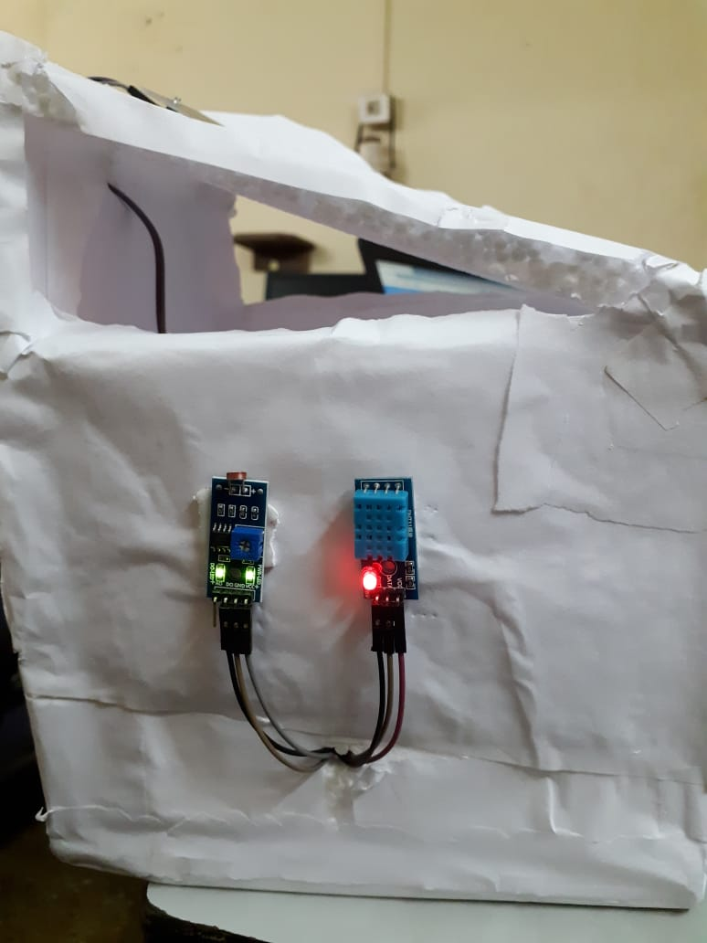
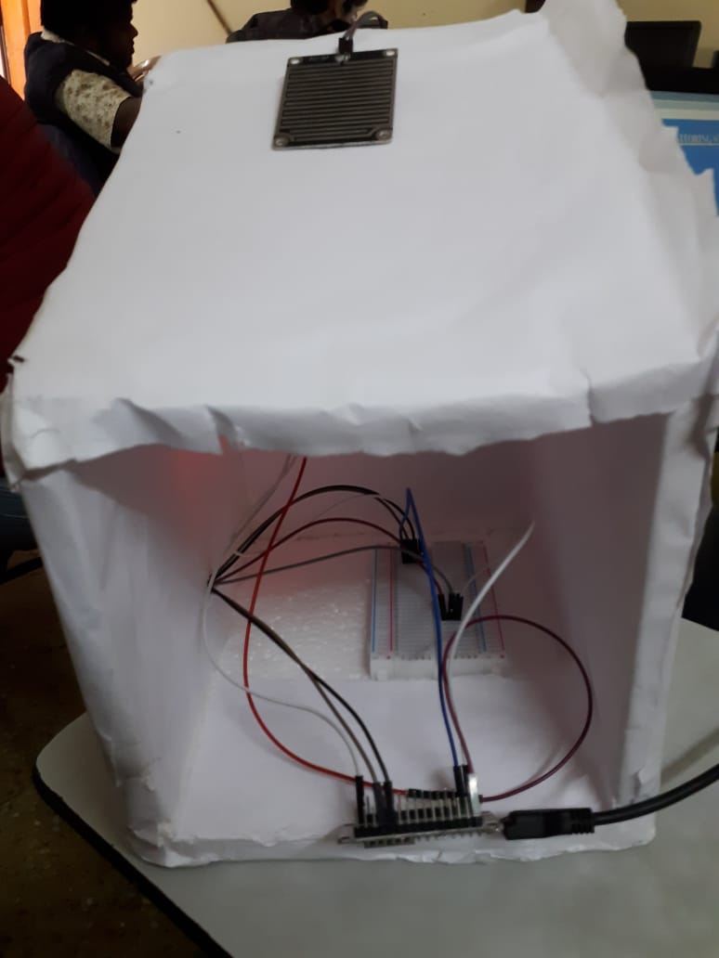
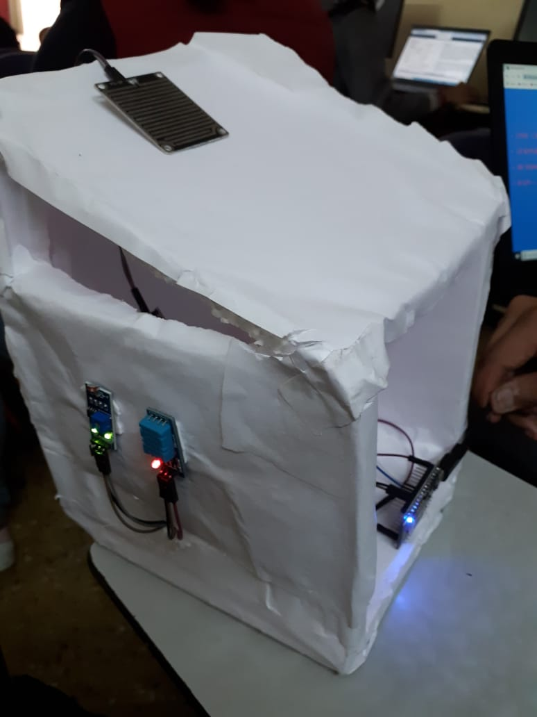
5.PROJECT PICTURE

Slide 14
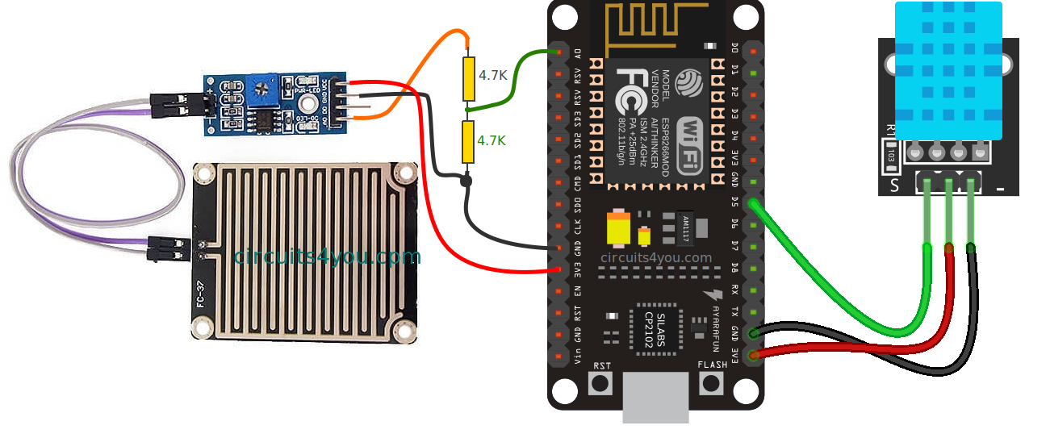
6.PROJECT CIRCUIT DIAGRAM

Slide 15
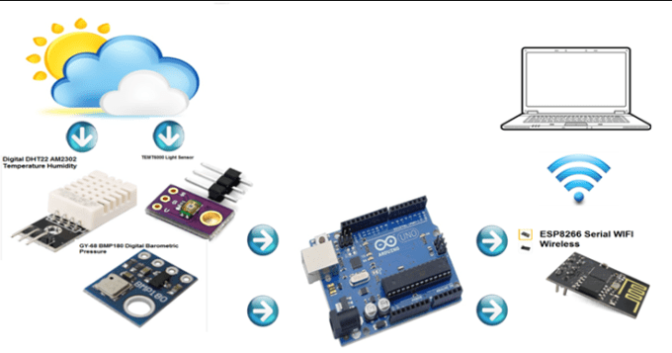

7.BLOCK DIAGRAM

Slide 16
8.RESULT In this result, local server shown a smart weather monitoring system in 10 second time interval . It showed four parameters, humidity, temperature, day and night detection, rain detection .

Slide 17
9.CONCLUSION This project is designed and developed for weather monitoring and controlling system. In the introduction, it describes the weather parameters and objectives of the project. It also describes the justification of project and working scopes in real life. In this chapter, it describes the details about the system flow of this project. In design and development chapter, it describes the system design and hardware-software requirements. It also describes the connectivity diagram of the hardware system. Result chapter describes the output.

